Slide 1







agreenment
A Green Mentality for Collective Bargaining
A EU research project led by
Together with
With the financial support of

Slide 2
Project aims and rationale
The aim of Agreenment is to investigate, both theoretically and empirically, how and why collective bargaining can contribute to embed the principle of environmental sustainability into labour relations, without abandoning but reinvigorating the ideals of justice, equality and democracy that justify the traditional and selective goals of collective bargaining regulation and of the EU social model
The idea behind the project is that there is no contradiction between environmental sustainability and the fundamental principles and functions of labour regulation
Notes:
Explain how and why environmental sustainability can become relevant for collective bargaining while preserving the focus on redistributing and redressing inequality of bargaining power inherent in the employment relationship.

Slide 3
Policy and normative framework
The four pillars of the ILO’s Decent Work Agenda are now integrated in the UN 2030 Agenda for Sustainable Development: Goal No. 8 of the agenda seeks to “Promote inclusive and sustainable economic growth, employment and decent work for all”, by improving “progressively, through 2030, global resource efficiency in consumption and production and endeavour to decouple economic growth from environmental degradation”
Article 11 TFEU (and article 37 EUCFR): “Environmental protection requirements must be integrated into the definition and implementation of the Union policies and activities, in particular with a view to promoting sustainable development”

Slide 4
3 research steps
The research team will preliminarily develop a theoretical framework under which collective bargaining can be rethought in the light of the principle of sustainability (all co-applicants)
National case studies based on desk research (LR), interviews with social partners and analysis of collective agreements in 6 countries (all co-applicants, individually)
Comparison of national case studies (ADAPT + Juan, with the contribution of all co-applicants)

Slide 5
Products
6 national reports (30-40 pages)
1 comparative report (20-30 pages)
1 e-book in English, collecting the comparative report + national reports
1 policy toolkit, i.e. a short document collecting all the best measures and guidelines that can be implemented by social partners

Slide 6
Events
1 kick-off meeting in Rome (all co-applicants)
1 workshop with social partners per country (each co-applicant)
1 online mid-term workshop (all co-applicants)
1 final conference in Brussels (all co-applicants)

Slide 7
Gantt of the project
June 2018
May 2019
May 2020
 | 1 | 2 | 3 | 4 | 5 | 6 | 7 | 8 | 9 | 10 | 11 | 12 | 13 | 14 | 15 | 16 | 17 | 18 | 19 | 20 | 21 | 22 | 23 | 24
Internal meetings
International events
National events
Research
National reports
Comparative report
Dissemination

Slide 8






The partnership
Applicant organisation
Co-applicant organisations
Supporting partners

Slide 9
Applicants’ roles and responsibilities
Applicant organisation (ADAPT)
  Manage the project, coordinate the partnership and report to the EC
  Organise the kick-off meeting, the mid-term workshop and the final conference
  Create a cooperation platform and a website
  Research activities to draft the Italian report
  Organise the national workshop with Italian social partners
  Draft the comparative report with the scientific director
  Edit the e-Book
  Dissemination activities
Co-applicant organisations
  Participate in the project events
  Research activities to draft the national report
  Organise the national workshop with social partners
  Cooperate in the drafting of the comparative report and the policy toolkit
  Dissemination activities

Slide 10
agreenment
Kick-off meeting draft agenda
26 and 27 June 2018, Rome
A Green Mentality for Collective Bargaining
26 June, 14.00 – 18.30
14.00 welcome and registration
14.30 ADAPT introduction to the project
16.00 round table with all partners
A EU research project led by
27 June, 09.00 – 17.00
Together with
09.00 session on methodological issues
13.00 light lunch
14.00 session on contract management issues
15.00 next steps
16.00 AOB
Venue
With the financial support of
The meeting will take place at the ADAPT office in Rome, Cavour street, 57 (5 minute walk from Termini station)
Info
tomassettipaolo@gmail.com
+39 3384672372

Slide 11
Methodological aspects from project proposal
Countries: France, Hungary, Italy, the Netherlands, Spain, the UK
Sectoral focus: to be discussed
Literature review to analyse previous scientific research on the objective of the research
Interviews with national social partners to collect information on policies and best/worst practices and to analyse their views and opinions on the integration between labour and environmental protection (3 employers' representatives; 3 trade unions)
Analysis of collective agreements to identify existing provisions functional to environmental protection (directly or indirectly)
Notes:
Indirectly: welfare provisions

Slide 12
Traditional functions of collective bargaining
Redistribution (resources and power)
Redressing inequality of bargaining power by coordinating individual interests towards collective interests
A channel of voice for workers (industrial democracy)
Market control, i.e. taking wages and working conditions out of competition
Managerial control, i.e. resolving the conflict of interest inherent in the employment relationship
Balancing efficiency and equity

Slide 13
Economy
Labour law
Environmental law
Labour
Environment
Notes:
Polanyi
Sustainable development
Just transition law
Environmental labour studies
La ecologia del trabajo

Slide 14
Environment
Our project
How and why collective bargaining can contribute to embed the principle of environmental sustainability into labour relations, without abandoning but reinvigorating the ideals of justice, equality and democracy that justify the traditional and selective goals of collective bargaining regulation and of the EU social model
Labour
Economy

Slide 15
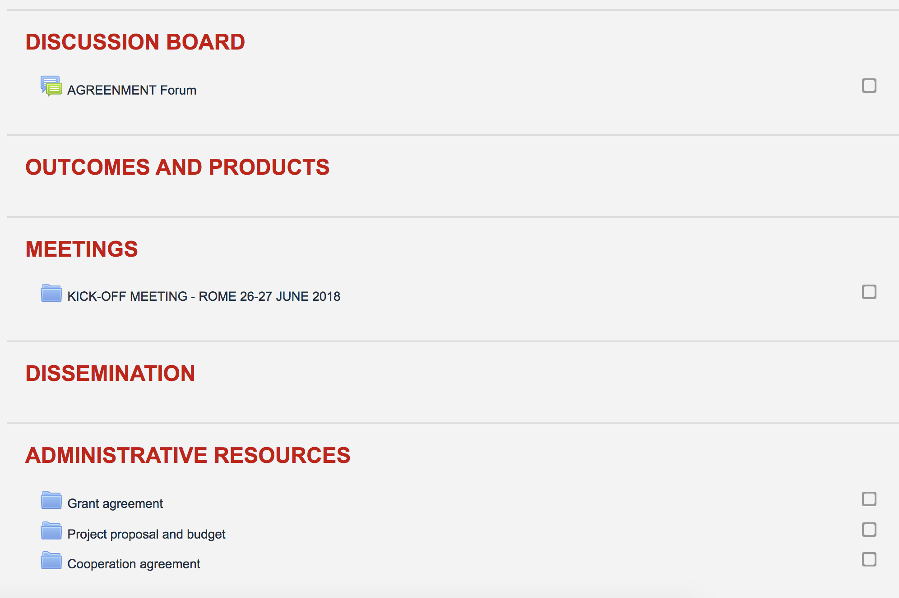
Moodle cooperation platform
https://moodle.adaptland.it/course/view.php?id=649

